Slide 1

21141017 Md Shahriyar Hossain
21341031 Mohammed Julfikar Ali Mahbub
21341049 G M Sohanur Rahman
Group 05
Code-Switching Patterns Can Be an Effective Route to Improve Performance of Downstream NLP Applications: A Case Study of Humour, Sarcasm and Hate Speech Detection
Srijan Bansal | Garimella Vishal | Ayush Suhane | Jasabanta Patro | Animesh Mukherjee
Proceedings of the 58th Annual Meeting of the Association for Computational Linguistics

Slide 2
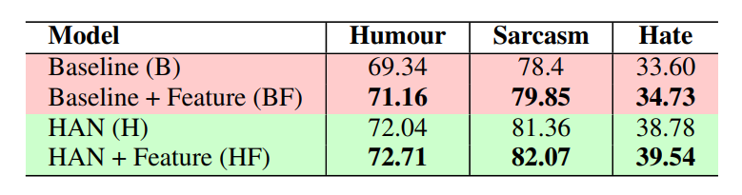
21341031 ABSTRACT Mohammed Julfikar Ali Mahbub
Abstract
They showed how codeswitching patterns can be used to improve various downstream NLP applications in this paper. To improve humour, sarcasm, and hate speech detection tasks, they encoded different switching features. They believe that this simple linguistic observation could be useful in improving other NLP applications in the future with any other languages as well.
Code-Switching Patterns Can Be an Effective Route to Improve Performance of Downstream NLP Application: A Case Study of Humour, Sarcasm and Hate Speech Detection

Slide 3
21341031 INTRODUCTION Mohammed Julfikar Ali Mahbub
Introduction
NLP Research Community
Explore Properties
Designed
for
Code-mixing
Down Stream Applications
Motivation
There is a strong preference for swearing in the dominant language when people code-switch.
The present work
Humour Detection
Sarcasm Detection
Hate Speech Detection
Introduced
Modern Deep Neural Model
2.62%
1.85%
3.36%
Code-Switching Patterns Can Be an Effective Route to Improve Performance of Downstream NLP Application: A Case Study of Humour, Sarcasm and Hate Speech Detection

Slide 4

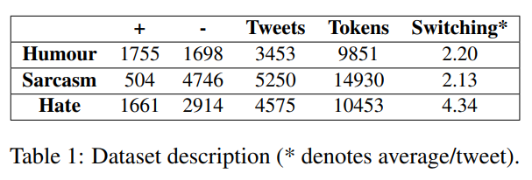
21341049 Dataset G M Sohanur Rahman
Dataset
Humour | Sarcasm | Hate
Politics | Public Protests | Riots
Non-Hateful Tweets
Scraped from
Negative Class
Used Hashtags to mined tweets
Positive Class
Hateful Tweets
Code-Switching Patterns Can Be an Effective Route to Improve Performance of Downstream NLP Application: A Case Study of Humour, Sarcasm and Hate Speech Detection

Slide 5
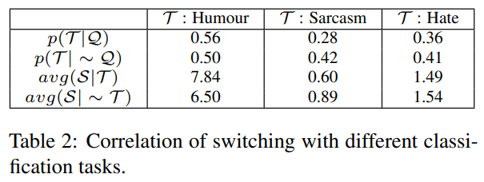
21341049 Switching features G M Sohanur Rahman
Switching and NLP tasks
It is important to understand how switching behavior is related to the three NLP tasks. Let Q be the property that a sentence has English words which are surrounded by Hindi words, that is there exists an English word in a Hindi context. Now, it has to perform a statistical analysis to determine the correlation between the switching patterns and a classification task at hand (represented by T)
Construction of the feature vector
A vector hi en[i] denotes the number of Hindi (hi) words before the i th English (en) word. This can also be interpreted as the run-lengths of the Hindi and English words in the code-mixed tweets. Based on these vectors they define nine different features that capture the switching patterns.
Code-Switching Patterns Can Be an Effective Route to Improve Performance of Downstream NLP Application: A Case Study of Humour, Sarcasm and Hate Speech Detection

Slide 6
21341049 Experiments… G M Sohanur Rahman
Pre-processing
Aadab
Arz
Hai
Hashtag
Mention
URL
Tokenized Tweets
Converted to String
To Capture
Segregated Into
#AadabArzHai
General Semantics
Camel-case Hashtags
Machine learning baselines
Character N-grams
Tokenization
Expensive Text Preprocessing Techniques
Does not Require
Stemming
Removal of Stop Words
Code-Switching Patterns Can Be an Effective Route to Improve Performance of Downstream NLP Application: A Case Study of Humour, Sarcasm and Hate Speech Detection

Slide 7
21341031 … Experiments… (Machine Learning) Mohammed Julfikar Ali Mahbub
Can be used in
Humour baseline
Codemixed Texts
Are
Language Independent
N-grams
Bag-of-Words
Common words
Hashtags
Machine Learning Model
Used to train
Does not require
Time-consuming Pre-processing
Tokenization
Stemming
Sarcasm baseline
Support Vector Machine
Random Forest
Among top 500
Uses
Used To Train
Relevant Words
Word N-grams
As
Character Emoticons
Features
Model
Sarcasm Indicative
Code-Switching Patterns Can Be an Effective Route to Improve Performance of Downstream NLP Application: A Case Study of Humour, Sarcasm and Hate Speech Detection

Slide 8
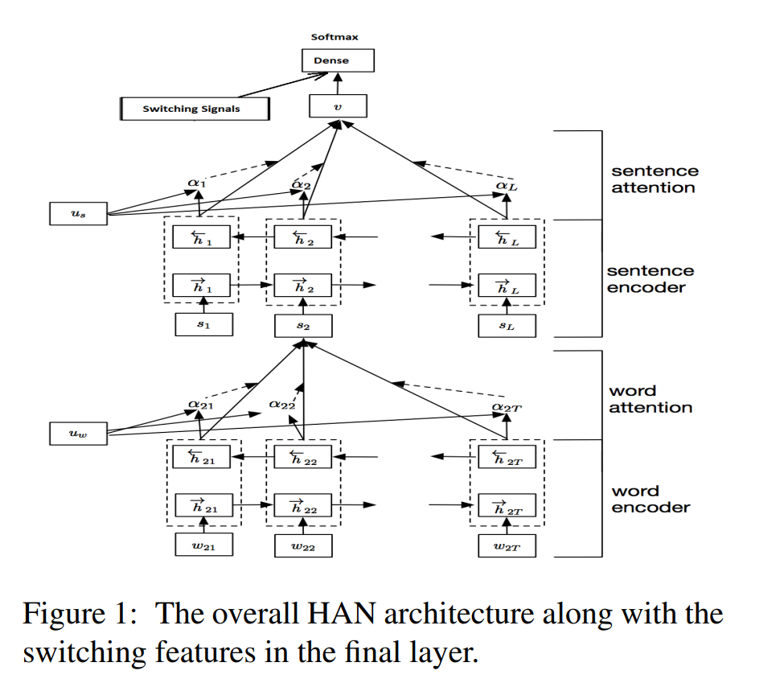
21141017 … Experiments… (Machine Learning) Md. Shahriyar Hossain
Hate baseline
Random Forest
Character N-grams
Used
Classifiers
Features
Support Vector Machine
Word
N-grams
Consists of
Negation Words
To decrease the dimensionality of
Lexicon of Hate Indicative Tokens
Used
Chi-squared Feature Reduction Method
Code-Switching Patterns Can Be an Effective Route to Improve Performance of Downstream NLP Application: A Case Study of Humour, Sarcasm and Hate Speech Detection

Slide 9
21141017 … Experiments… (Deep Learning) Md. Shahriyar Hossain
Deep learning architecture
In order to draw the benefits of the modern deep learning machinery, they built an end-to-end model for the three tasks at hand. Used the Hierarchical Attention Network (HAN) which is one of the state-of-the-art models for text and document classification.
Code-Switching Patterns Can Be an Effective Route to Improve Performance of Downstream NLP Application: A Case Study of Humour, Sarcasm and Hate Speech Detection

Slide 10
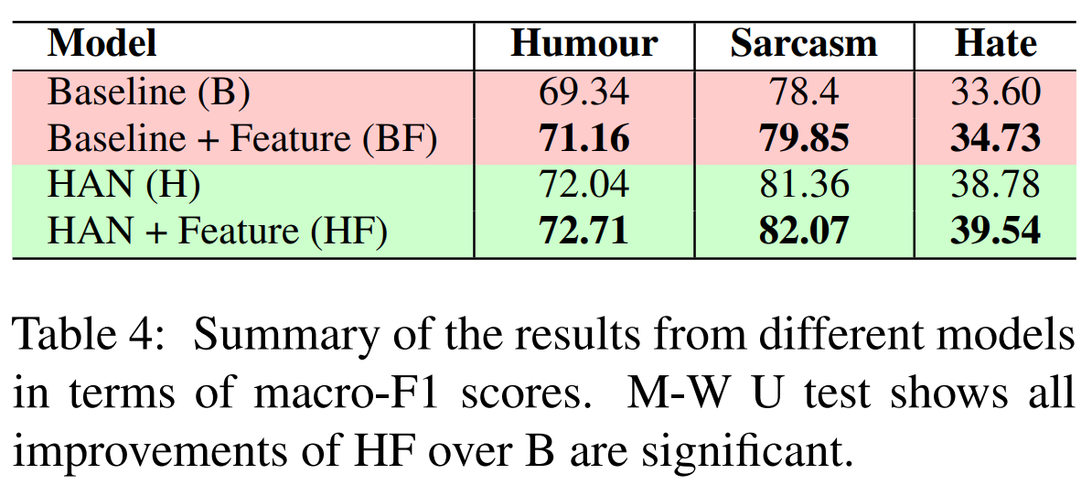
21141017 … Experiments Md. Shahriyar Hossain
Experimental Setup
For all datasets, they maintain a train-test split of 0.8-0.2 and perform 10-fold cross validation. They have obtained pretrained embeddings by training GloVe from scratch using the large code-mixed dataset (725173 tweets) and all the tweets (13278) in their three datasets.
Results
Inclusion of switching features into machine learning models allowed to obtain a macro-F1 improvement of 2.62%, 1.85% and 3.36% over the baselines (indicated as B in Table 4 ) on the tasks of humour detection, sarcasm detection and hate speech detection respectively.
Code-Switching Patterns Can Be an Effective Route to Improve Performance of Downstream NLP Application: A Case Study of Humour, Sarcasm and Hate Speech Detection

Slide 11
21141017 Conclusion Md. Shahriyar Hossain
Conclusion
In this paper, they identified how switching patterns can be effective in improving three different NLP applications. The presented a set of nine features that improve upon the state-of-the-art baselines. They used the modern deep learning machinery to improve the performance further.
While they have tested on one language pair (Hindi - English), their hypothesis is generic and has been already noted by linguists earlier (Vizca´ıno, 2011). Hence, we believe we can implement the idea and methodology for (Bangla – English) as well.
Code-Switching Patterns Can Be an Effective Route to Improve Performance of Downstream NLP Application: A Case Study of Humour, Sarcasm and Hate Speech Detection

Slide 12
21141017 The End Md. Shahriyar Hossain
Thank You!
Code-Switching Patterns Can Be an Effective Route to Improve Performance of Downstream NLP Application: A Case Study of Humour, Sarcasm and Hate Speech Detection

